Slide 1


CEIS 114 PROJECT
IoT Traffic Controller
Teyvone Wells

Slide 2
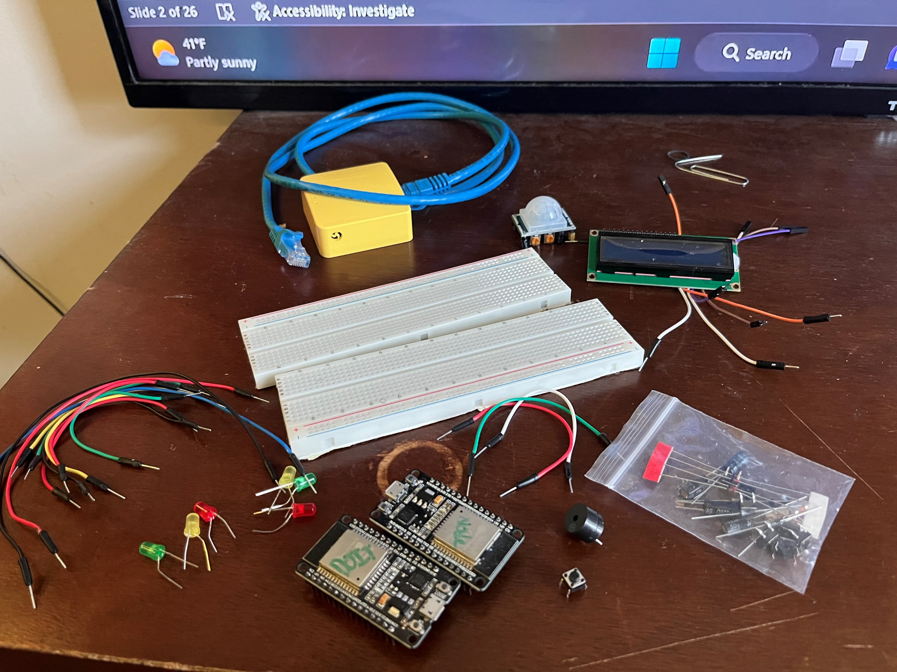
Inventory
ESP 32 Board
Colored LEDs: Red, Yellow, Green, and Blue
220 Ohm Resistors (optional)
Wires
Breadboard(s)
LCD Unit with I2C Adapter
Active Buzzer
Mini Router
Push Button(s)
PIR Motion Sensor

Slide 3
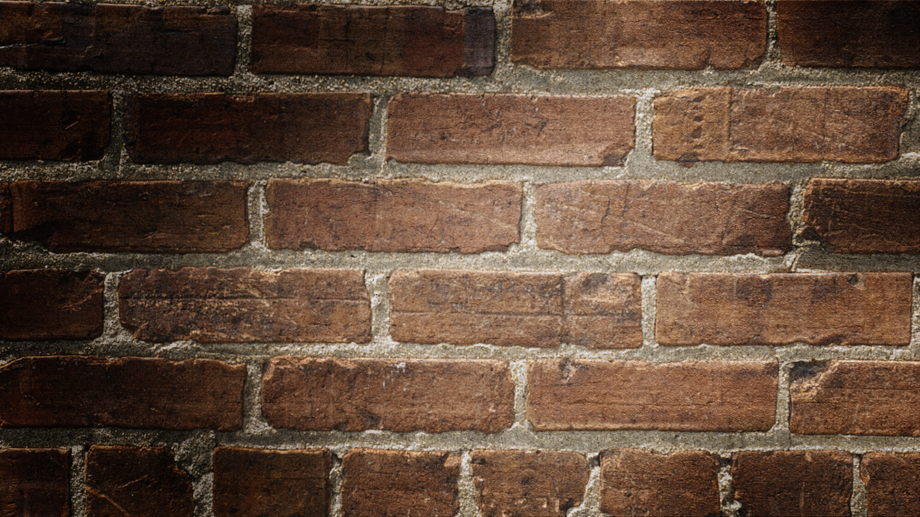
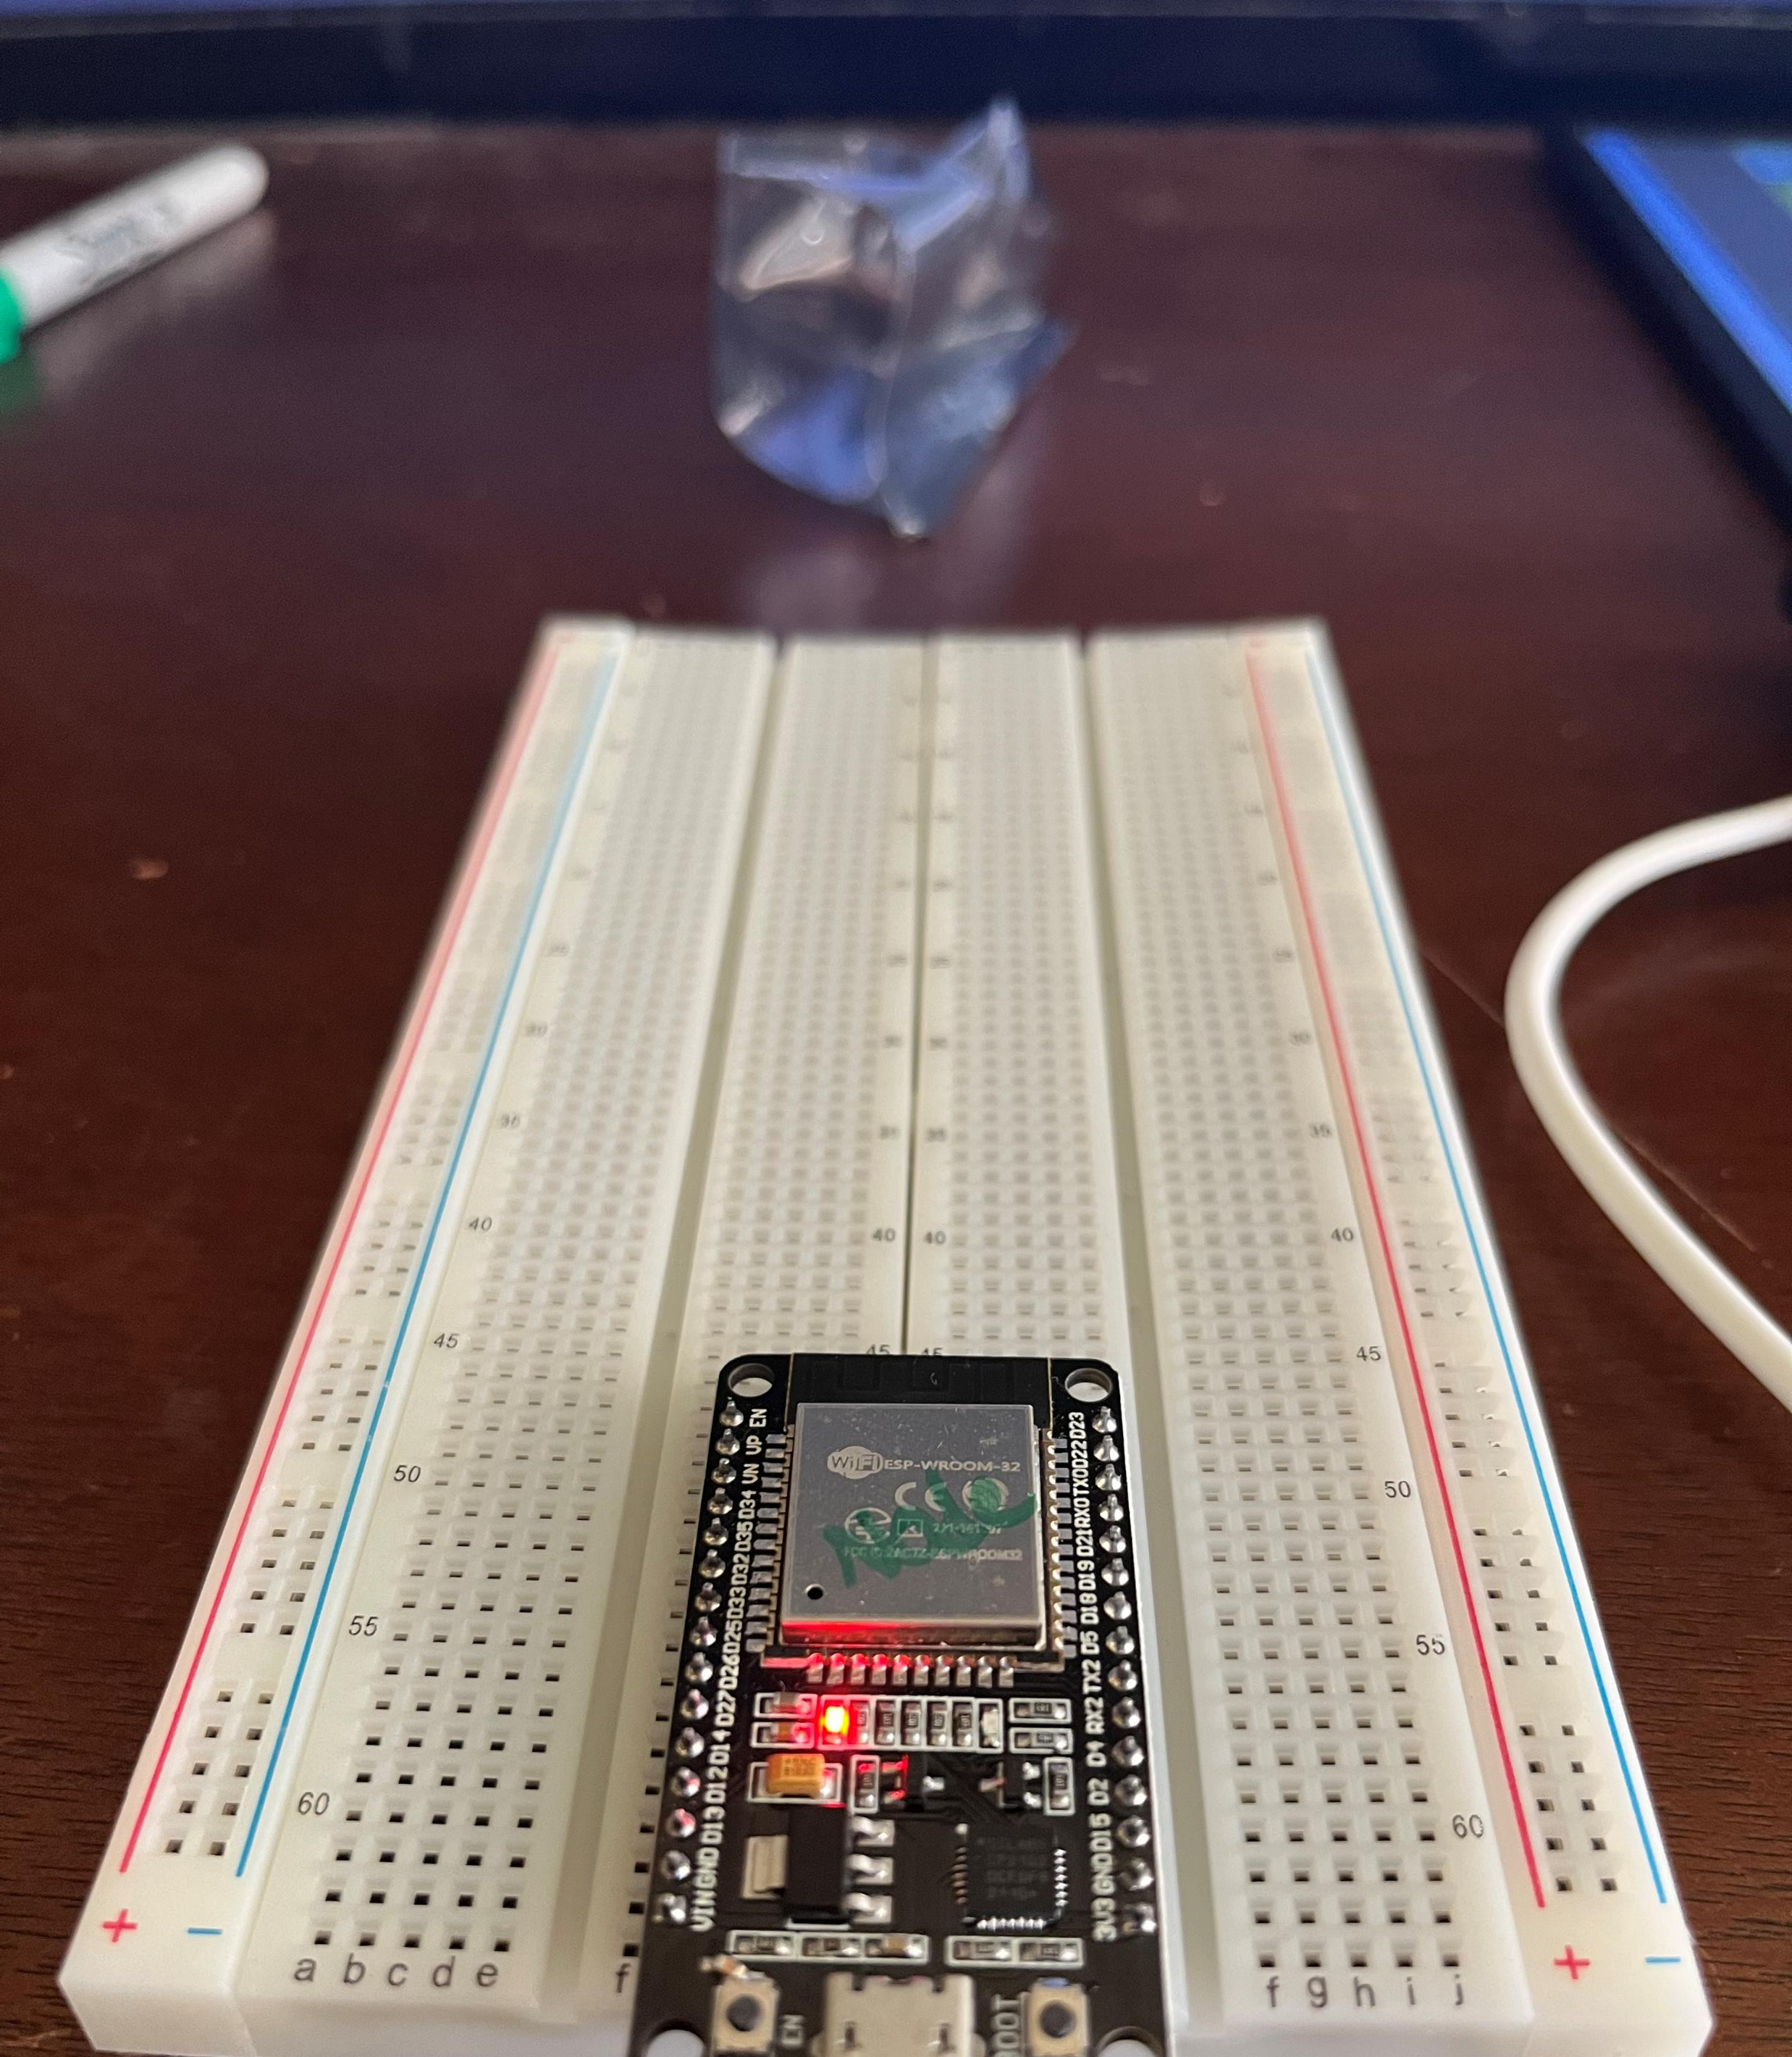
ESP32
Mounted Microcontroller (powered ON)
assembly of the Breadboards required

Slide 4
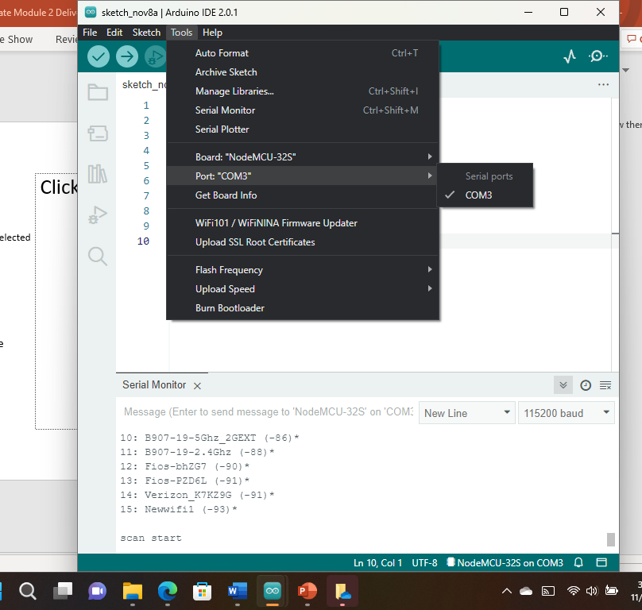
Installation of Arduino IDE
Screenshot of Arduino IDE with Port selected from Tools menu.

Slide 5
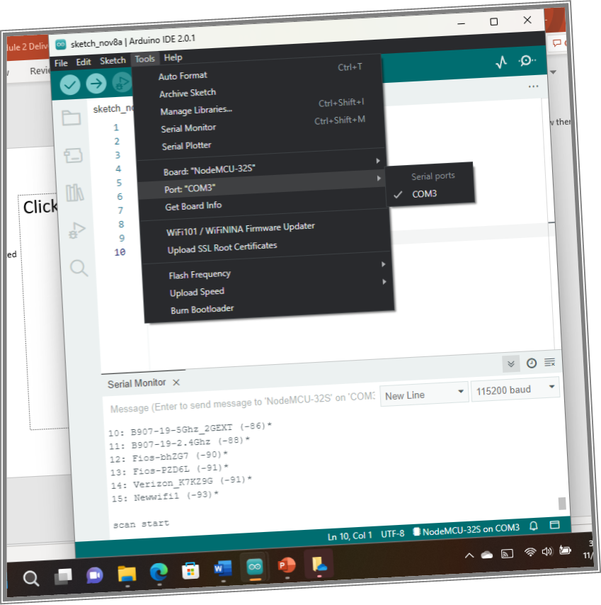
ESP32 WiFi Scan
Screenshot of Serial Monitor in Arduino IDE showing the available networks

Slide 6

Creating the Traffic Controller

Slide 7
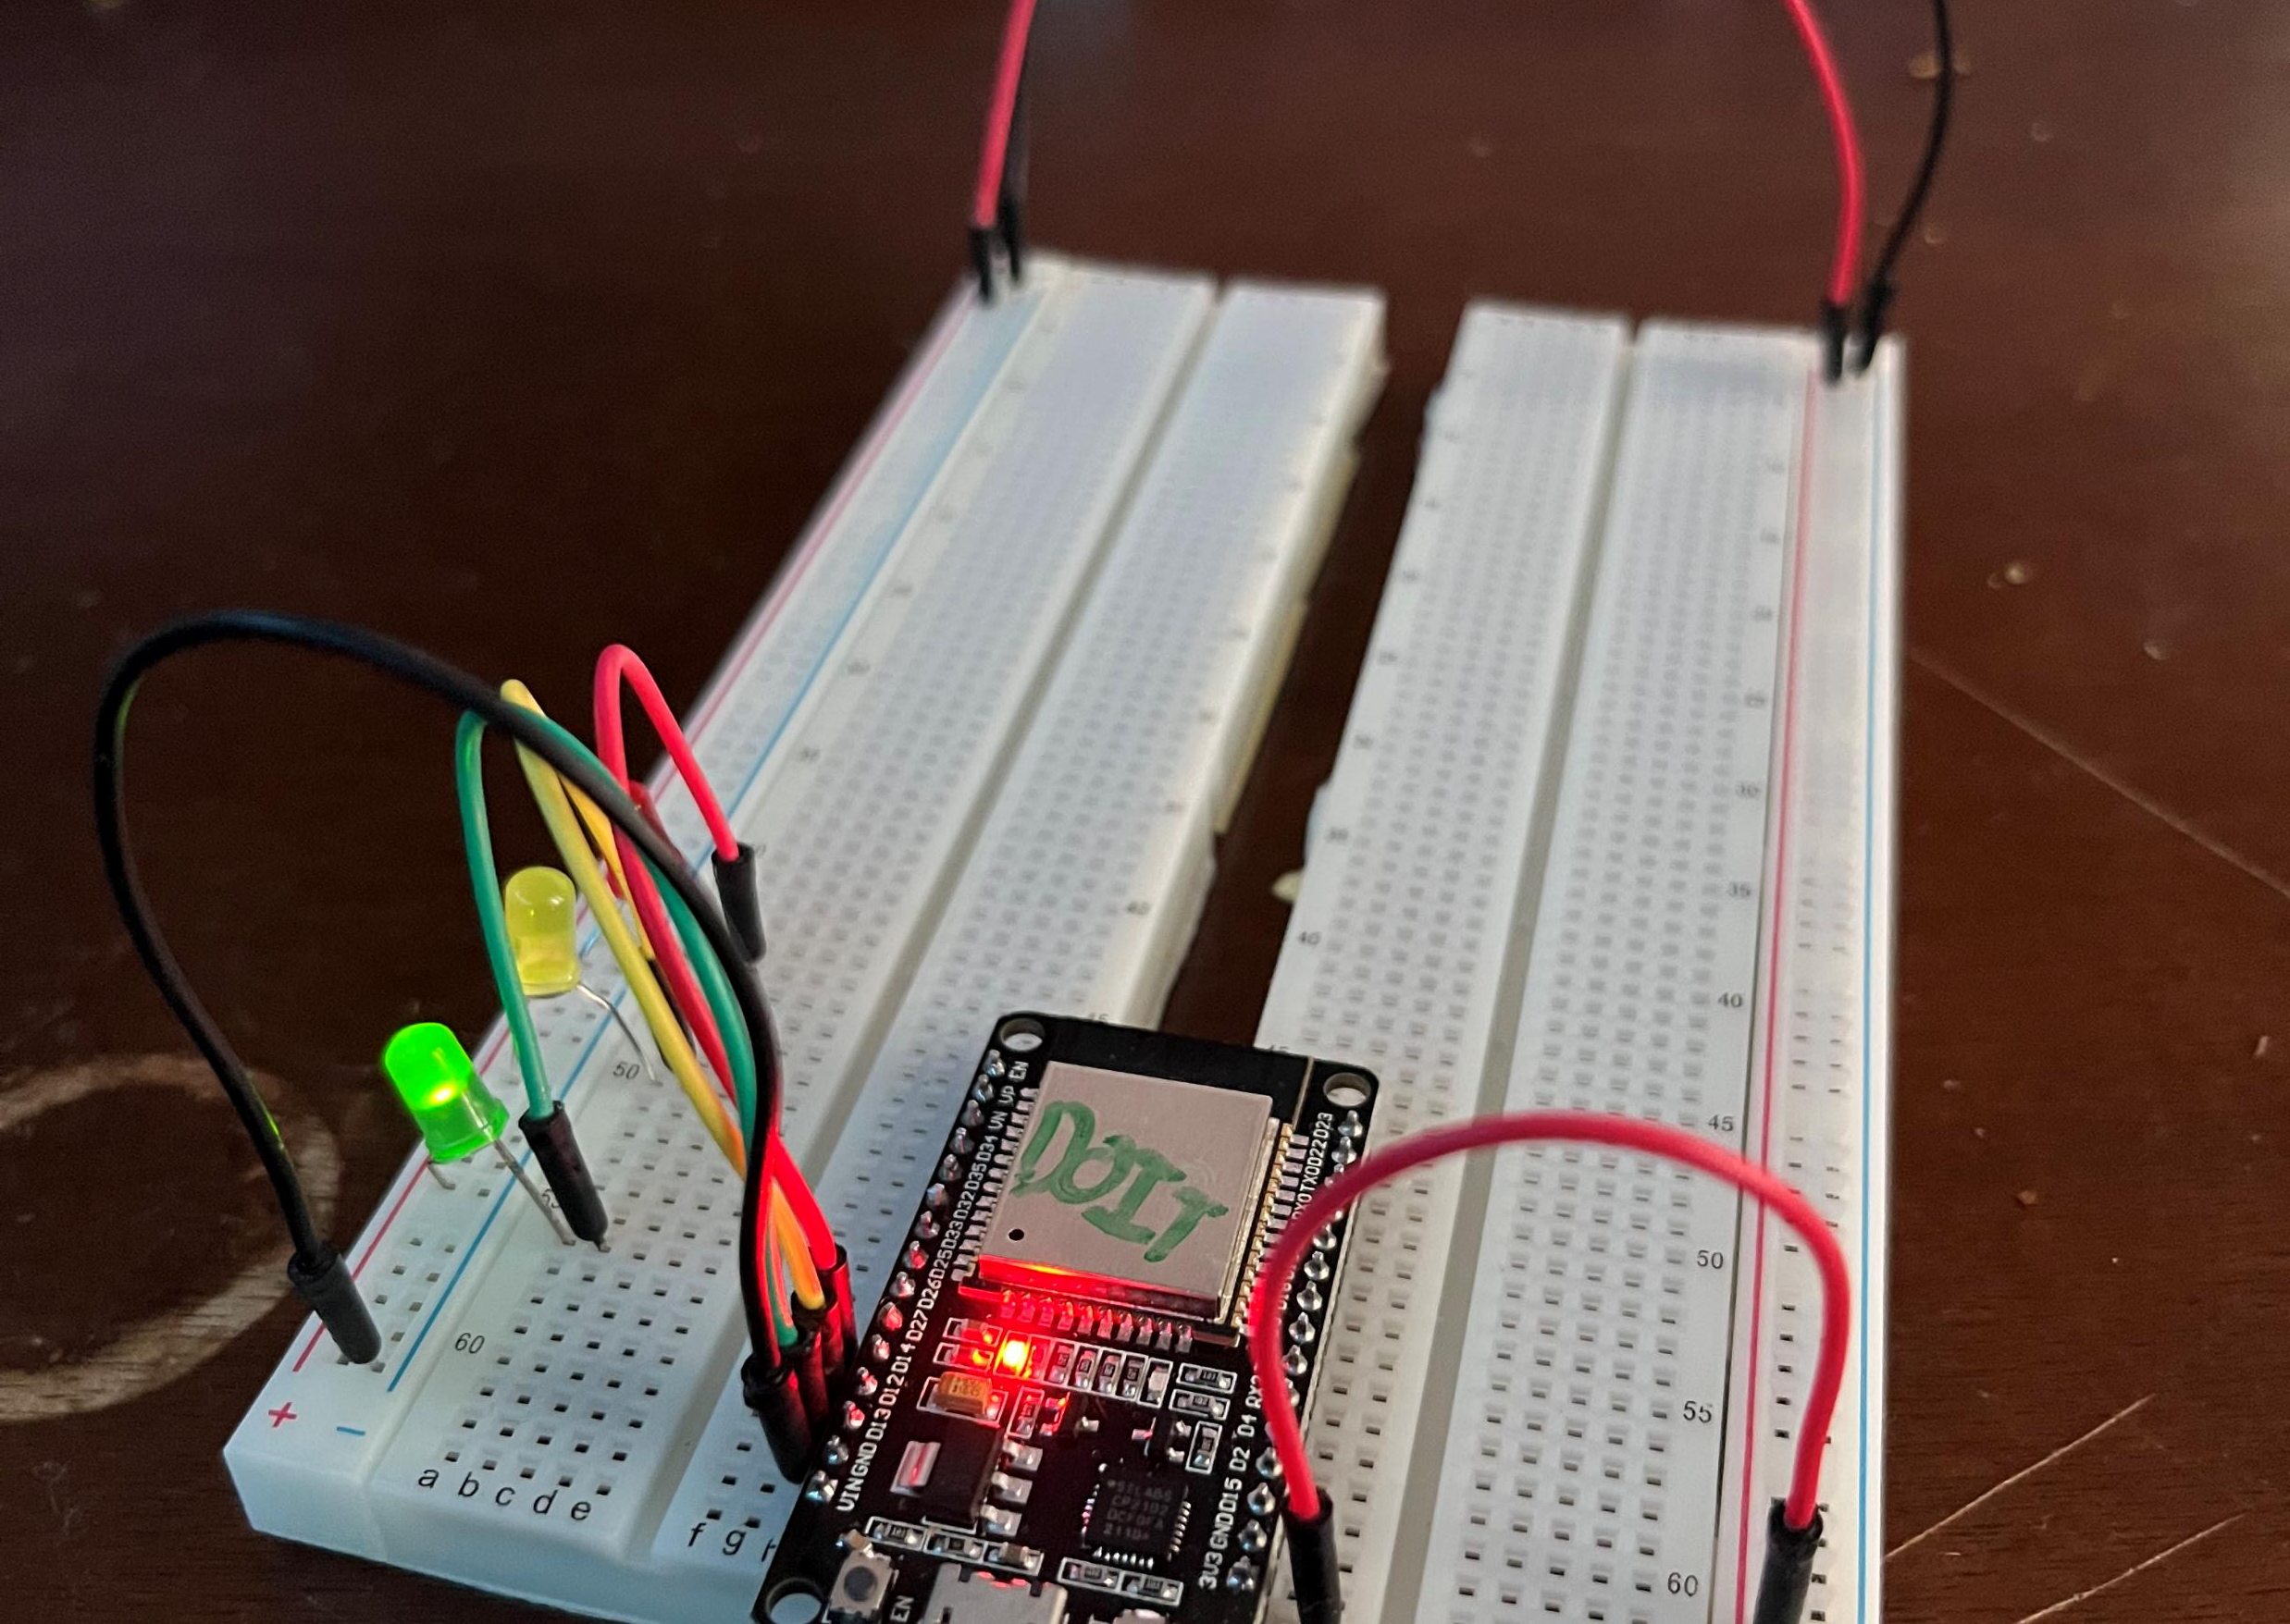
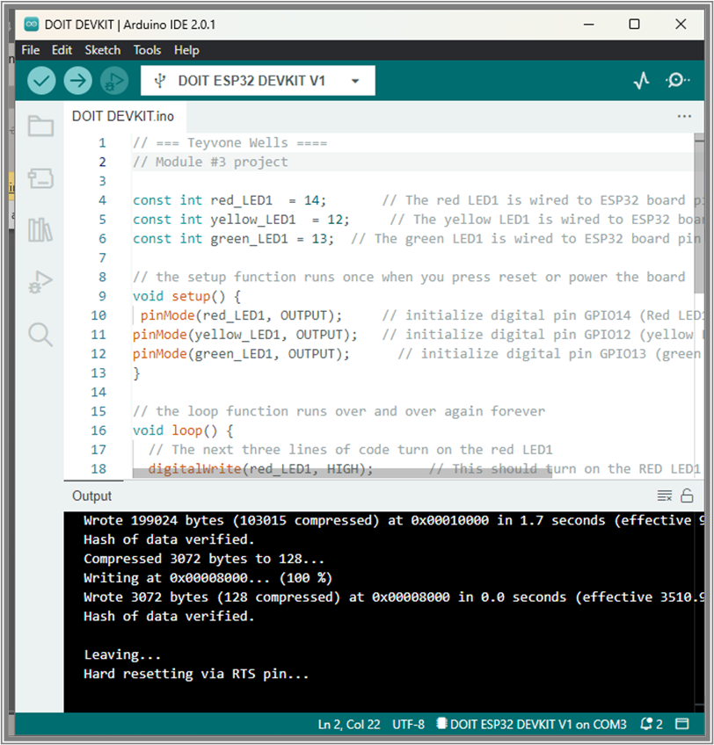
Picture of circuit with working LEDs
ESP 32 Board
Colored LEDs: Red, Yellow and Green
220 Ohm Resistors (optional)
Wires
Breadboard
Screenshot of code in Arduino IDE

Slide 8
Creating a Multiple Traffic Light Controller

Slide 9
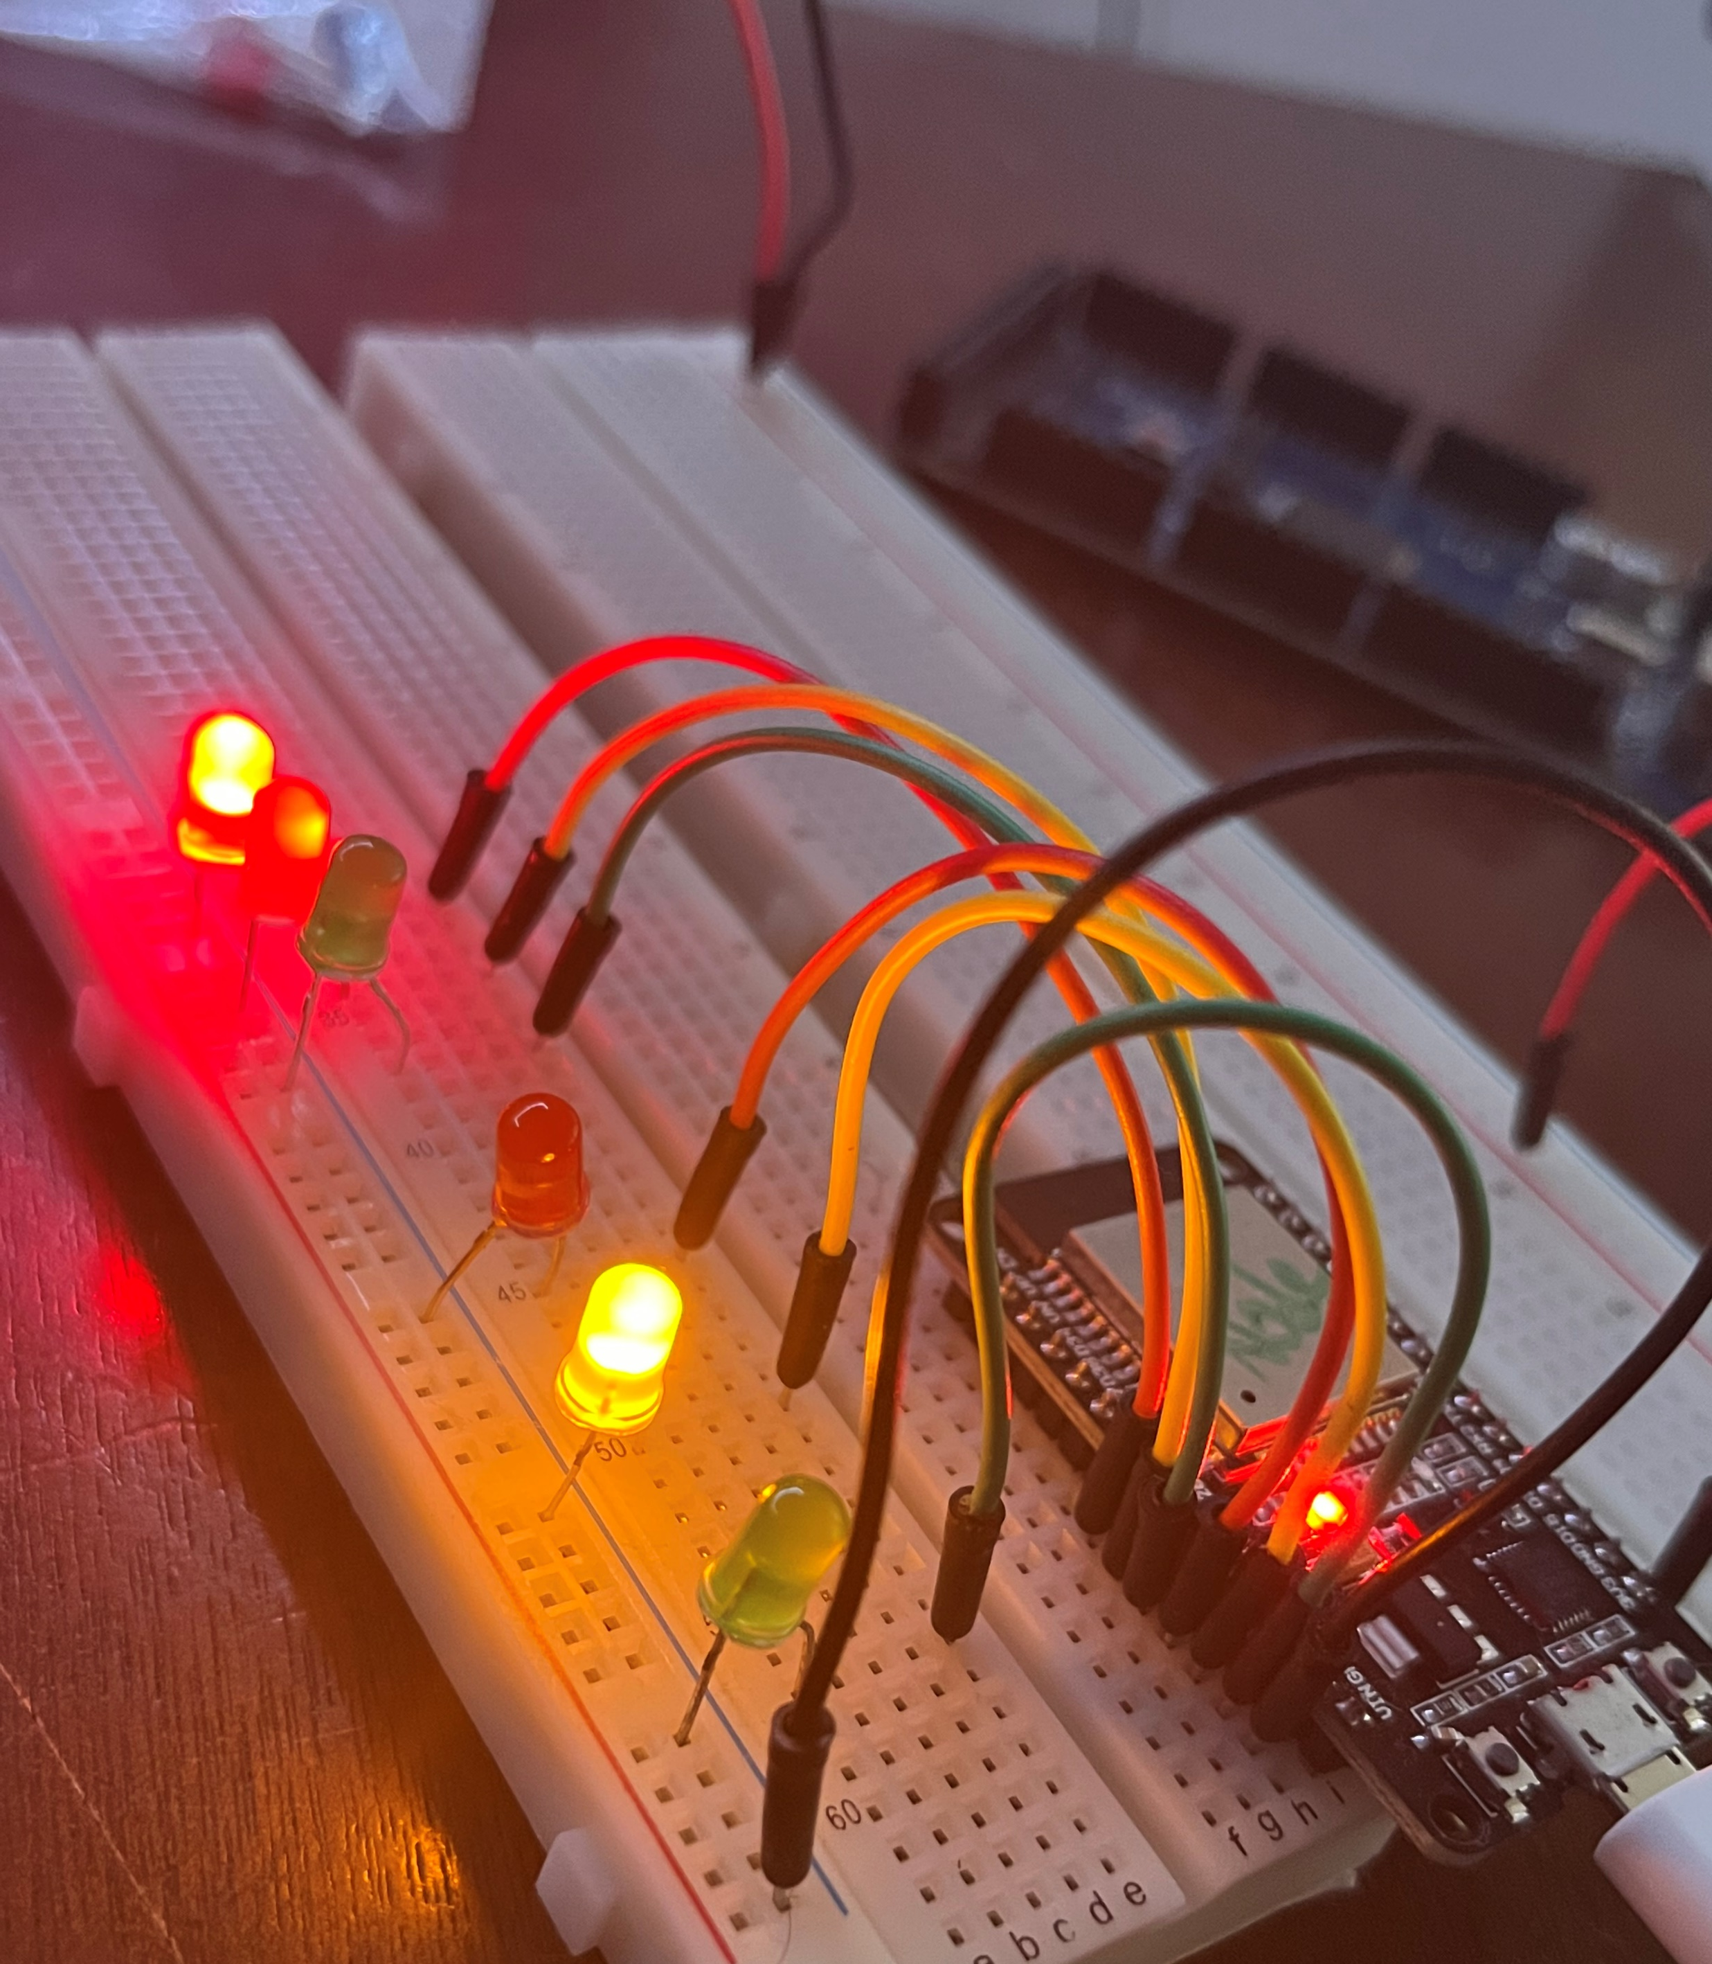
Picture of circuit with working LEDs
ESP 32 Board
Colored LEDs: Red, Yellow and Green (two sets)
220 Ohm Resistors (optional)
Wires
Breadboard

Slide 10
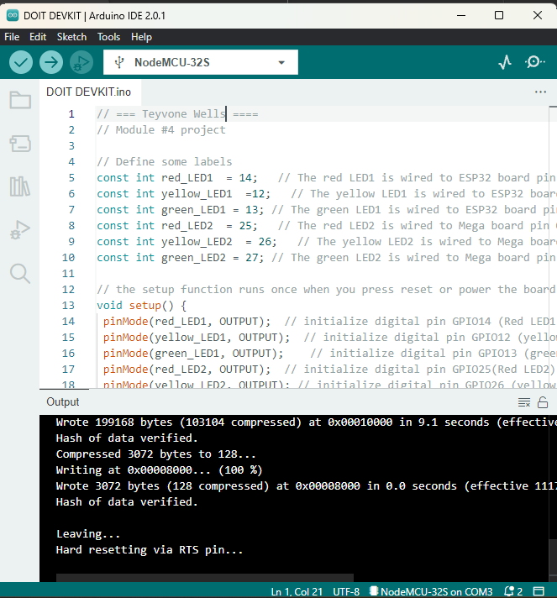
Screenshot of code in Arduino IDE
Screenshot of code in Arduino IDE showing your name in the comment

Slide 11
Creating a Multiple Traffic Light Controller with a Cross Walk

Slide 12
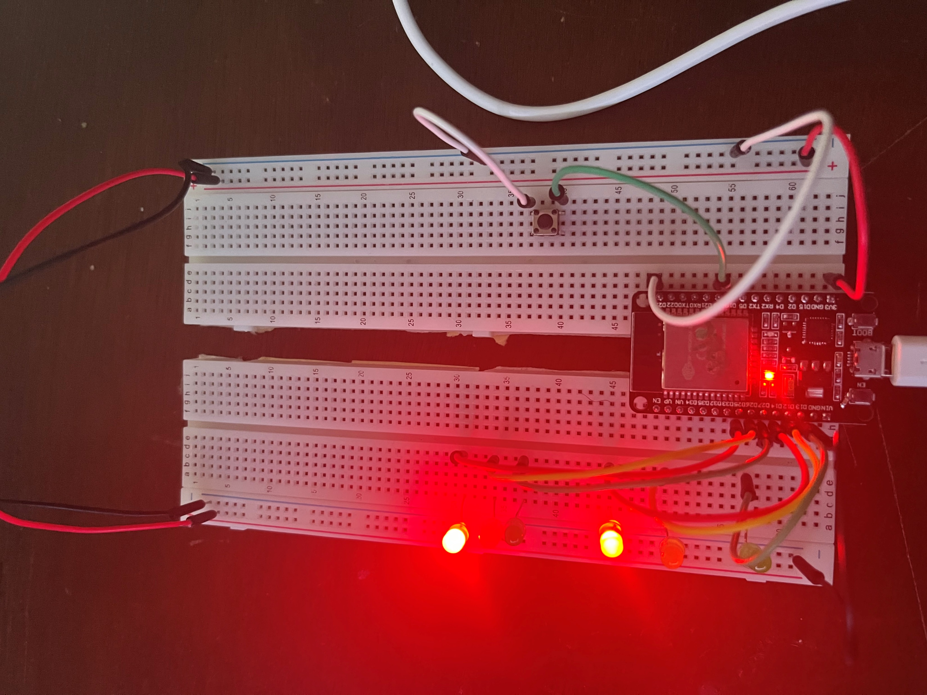
Picture of circuit with working LEDs (Walk)
ESP 32 Board
Colored LEDs: Red, Yellow and Green (two sets)
220 Ohm Resistors (optional)
Push Button
Wires
Breadboard

Slide 13
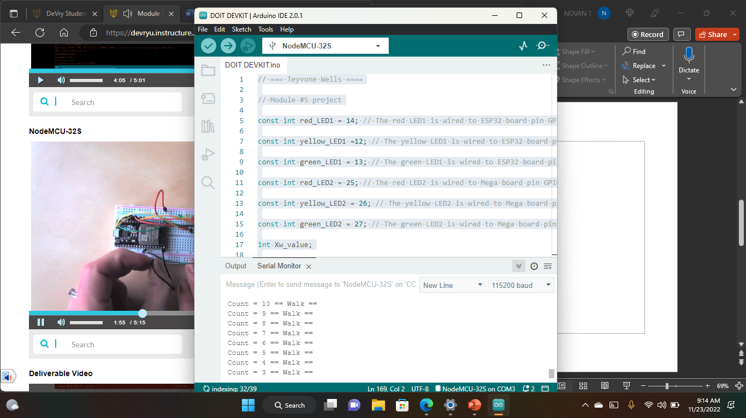
Screenshot of code in Arduino IDE
Screenshot of code in Arduino IDE showing your name in the comment

Slide 14
Screenshot of Serial Monitor in Arduino IDE
Screenshot of output in Serial Monitor

Slide 15
Creating a Multiple Traffic Light Controller with a Cross Walk and an Emergency Buzzer

Slide 16
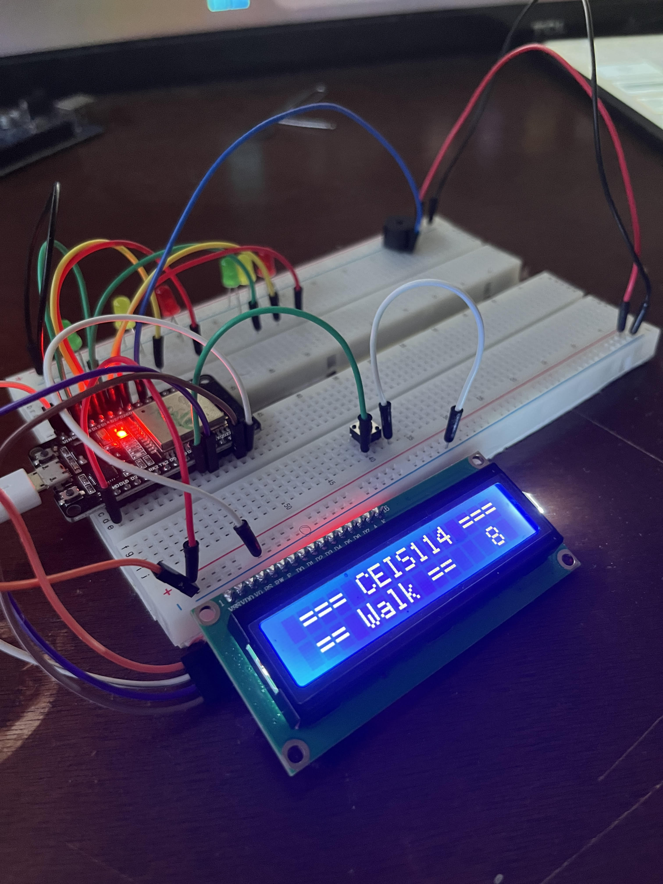
Picture of circuit with working LEDs and LCD display
ESP 32 Board
Colored LEDs: Red, Yellow and Green (two sets)
220 Ohm Resistors (optional)
Push Button
LCD Unit with Message Display
Wires
Breadboard

Slide 17
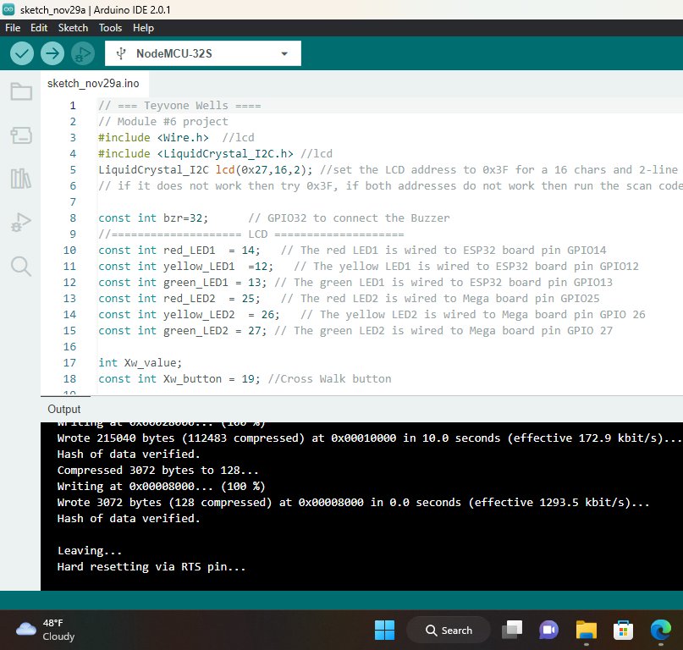
Screenshot of code in Arduino IDE
Screenshot of code in Arduino IDE showing your name in the comment

Slide 18
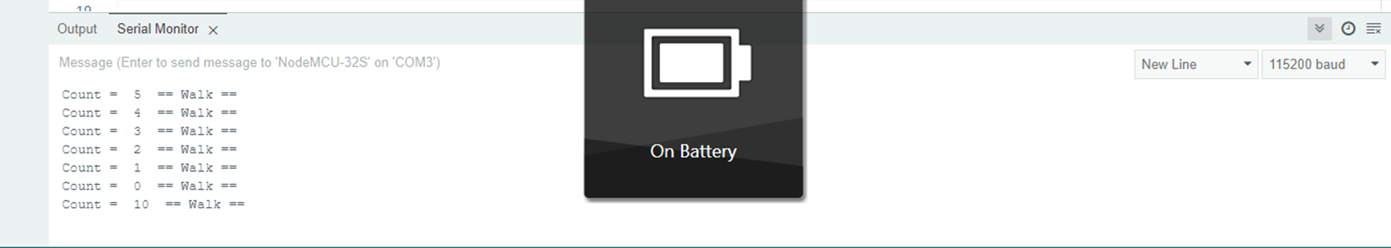
Screenshot of Serial Monitor in Arduino IDE
Screenshot of output in Serial Monitor

Slide 19
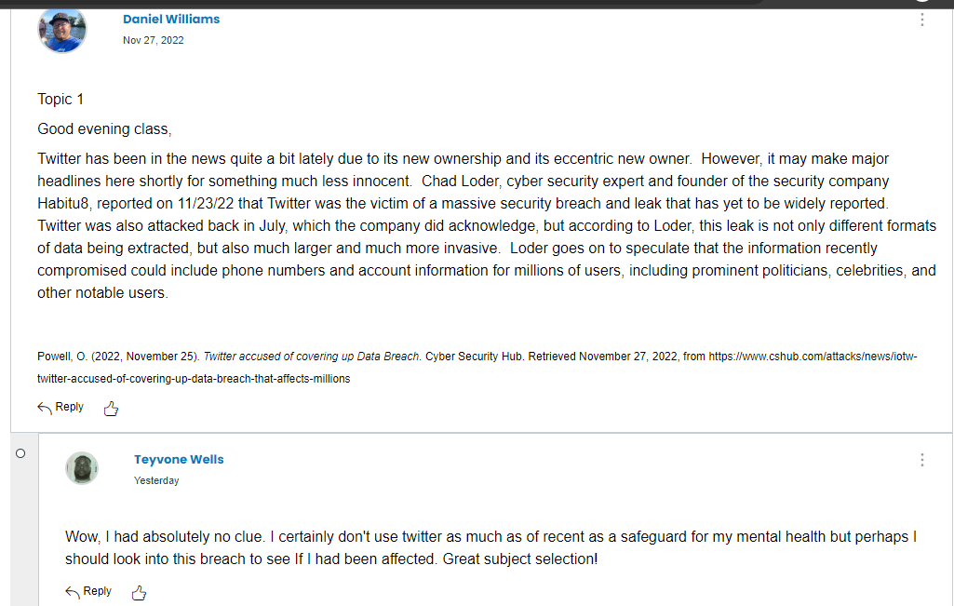
Peer Review 1
Q: As discussed in the lesson, security breaches are happening more and more often, and are affecting tens of millions of people: do an internet search to find recent events of security breaches and discuss your findings with relevant examples.

Slide 20
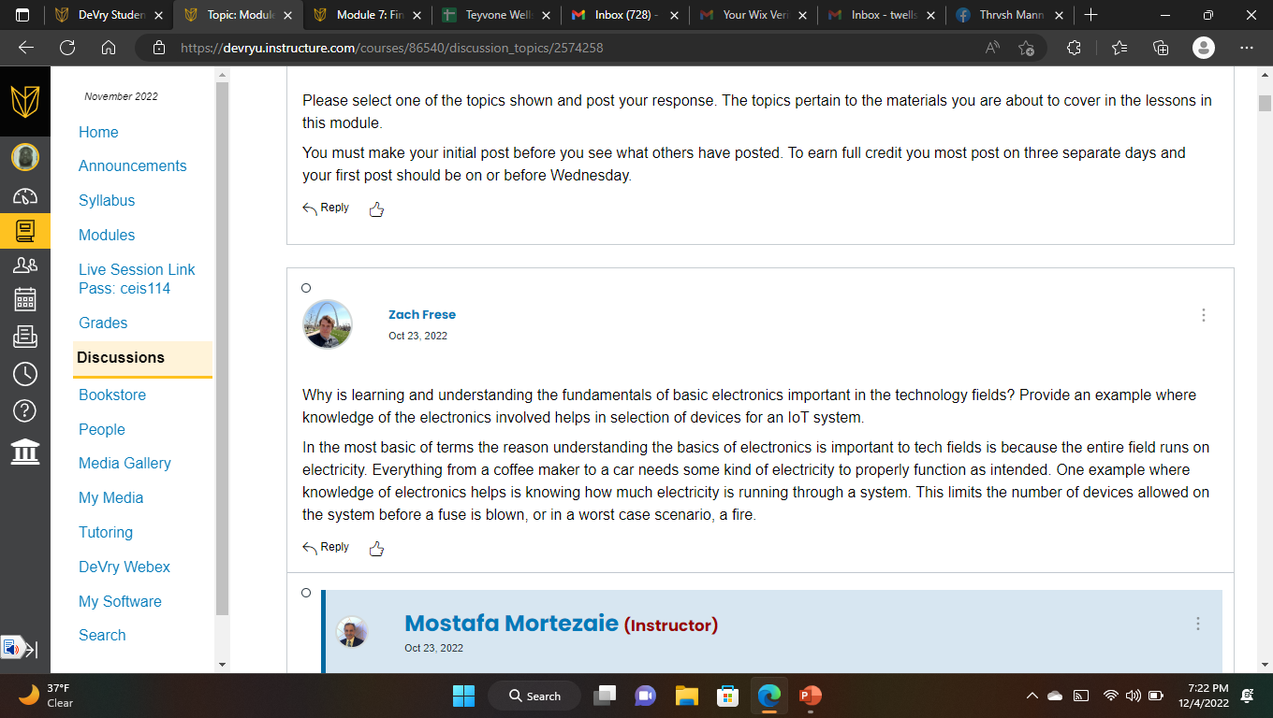
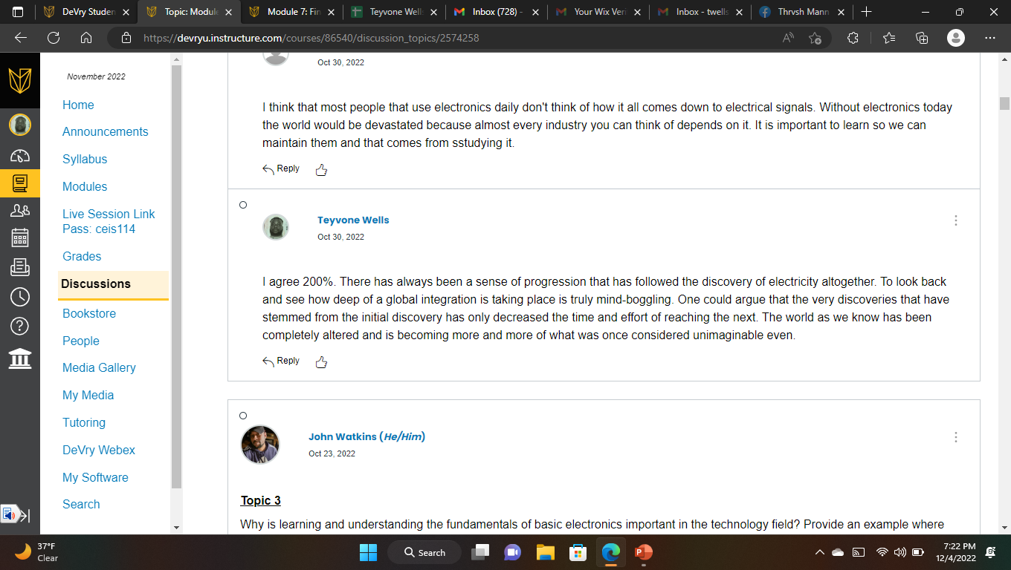
Peer Review 2
Q: Think of something that would make your life easier, anything from an automatic toothpaste dispenser to an awning that opens up when it senses rain, and imagine how you could actually create it. Do you agree with Massimo that the Arduino makes microcontrollers and coding available to anyone, regardless of experience?

Slide 21
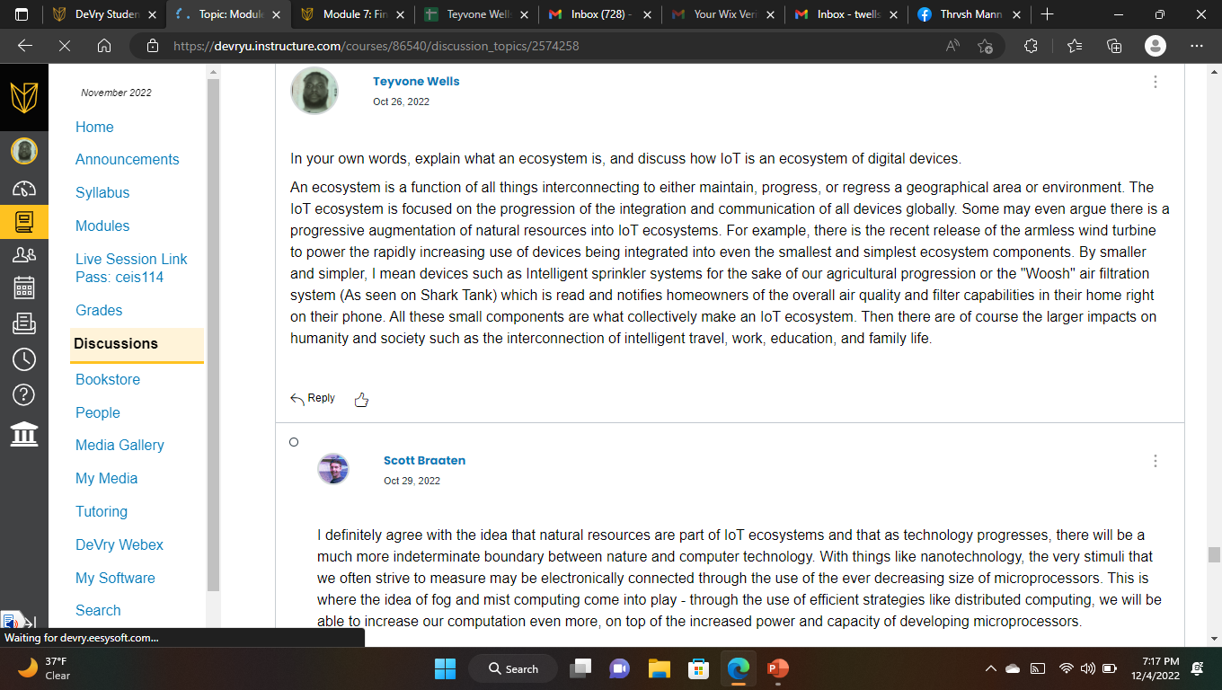
Peer Review Reflection

Slide 22
Challenges
I thoroughly enjoyed the assembly of this project so it was difficult to find and hold to much of a challenge. One small mistake I made during my assembly process was not paying enough attention to the proper distinguishment of ports on the Node32 microprocessor, LEDs, and Breadboards. There was a point I had come to the realization that I had certain wires connected to the wrong ports and referred to my Project guides from previous weeks to reconfigure them the correct way.

Slide 23
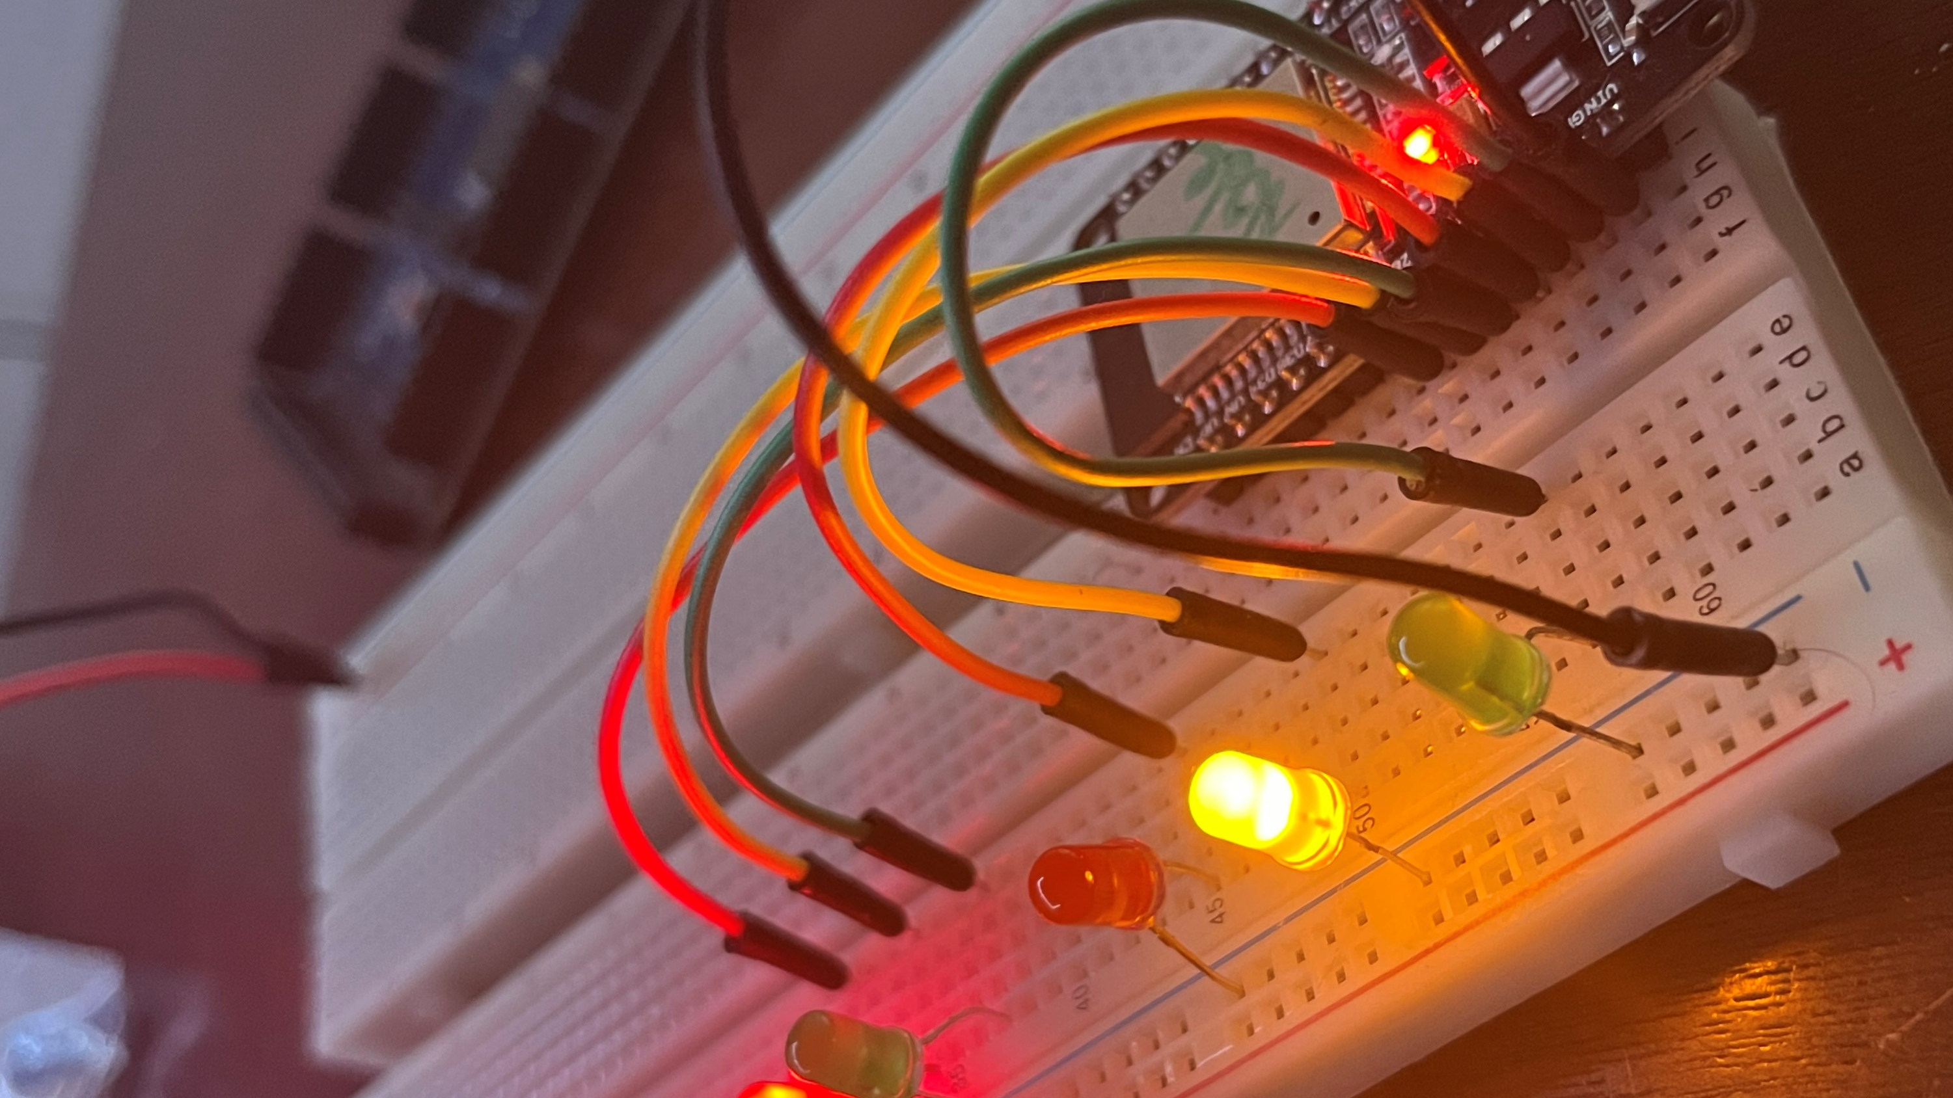
Career Skills
One major takeaway from completing this project is my understanding of circuitry and implementing functionality of all different kinds of devices. I am only far more excited to take more courses and gain further experience in completing these types of projects on my own. My ultimate goal is to build and own my own Tech company, so I naturally absorb every moment as if my desired future depends on it. My intent alone should thoroughly describe what career skills I have accumulated from completing this project being that these alone are my opportunity to get hands on practice with said concepts.

Slide 24
Closing Remarks
I enjoyed completing this project and would like to express my appreciation for Professor Mortezaie and my fellow classmates!

